Slide 1

Probability & Inference
Research Methods 1

Slide 2
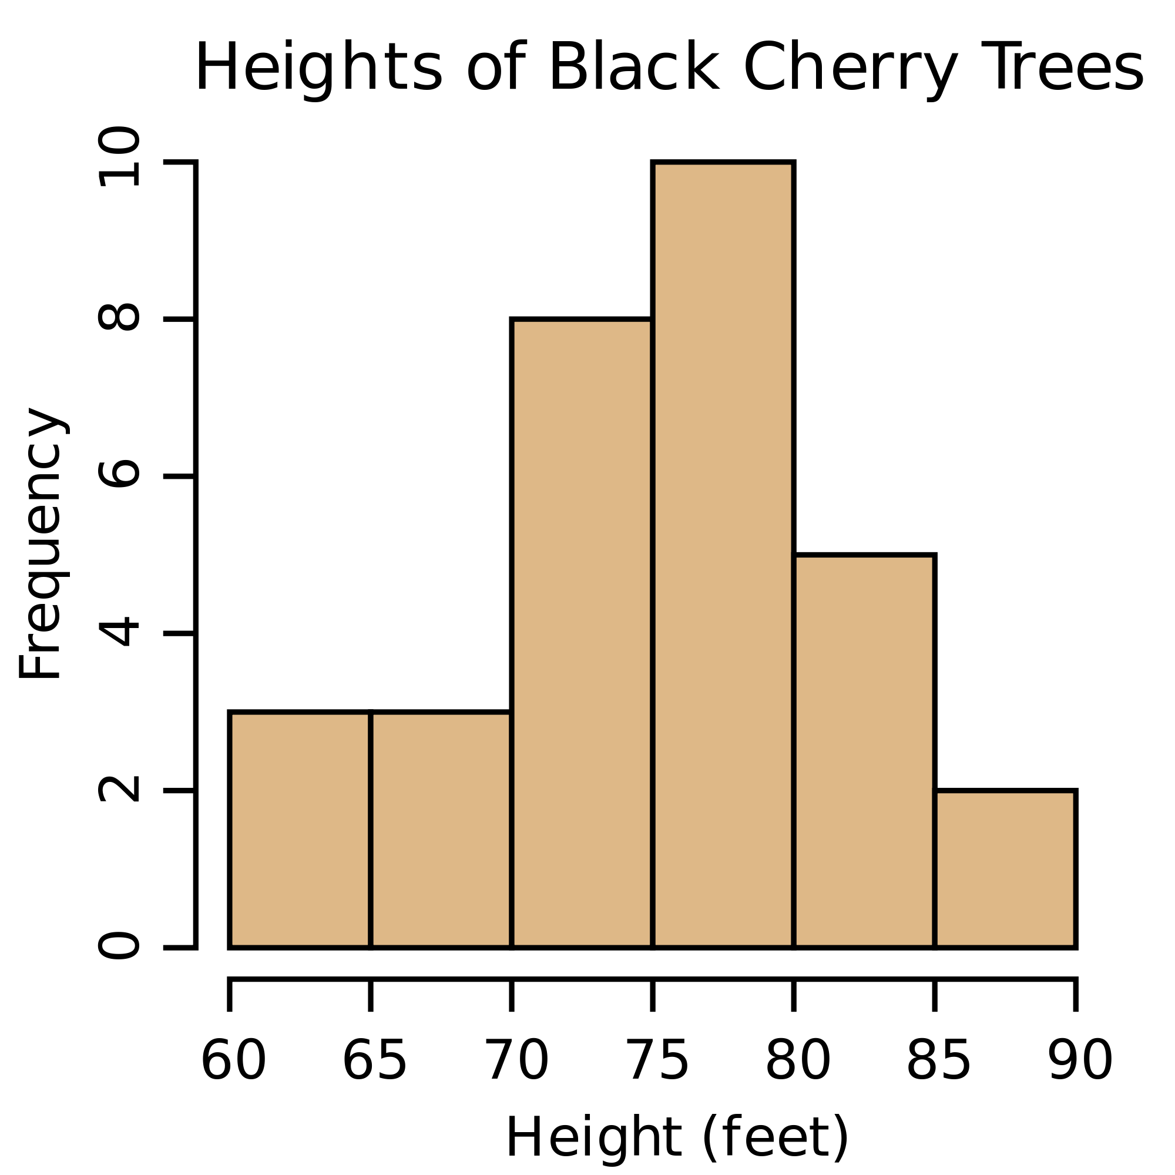
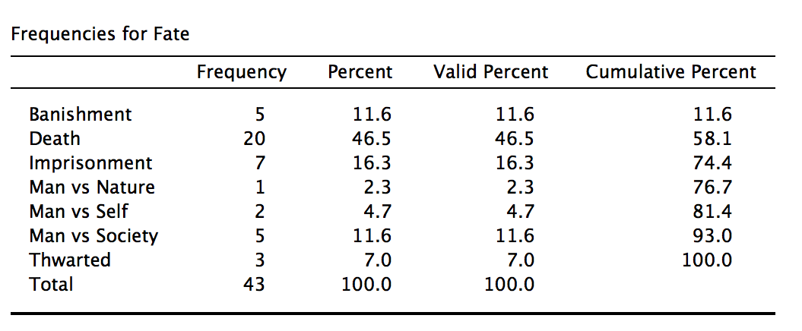
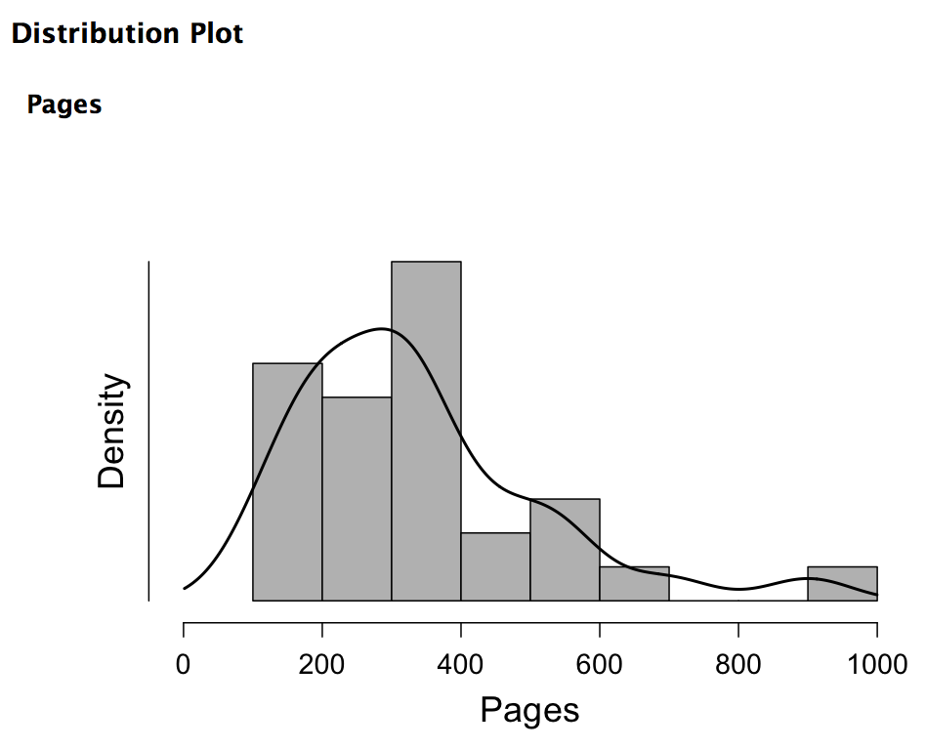
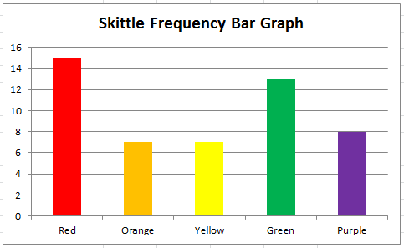
Frequency Distributions

Slide 3
Measures of central tendency
Mean: Average of all scores
Median: Middle value in a distribution
Mode: Most common response value

Slide 4
Measures of Variability
Range: Difference between highest and lowest scores
Variance (s² or σ²): The average of squared deviations from the mean
Standard Deviation (s or σ or SD ): The typical amount that each score varies (deviates) from the mean; the square root of the variance

Slide 5
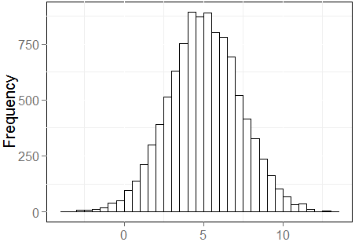
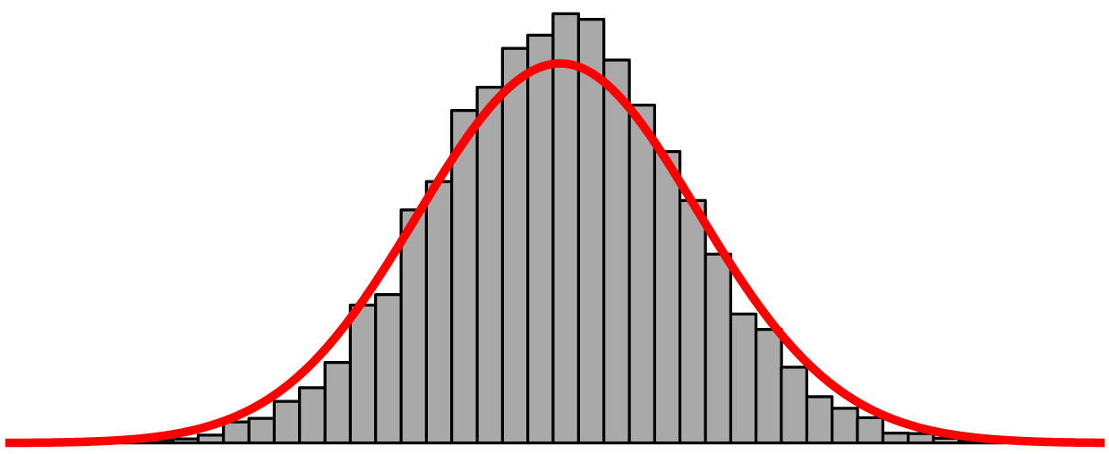
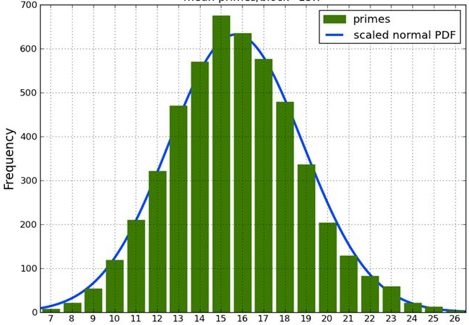
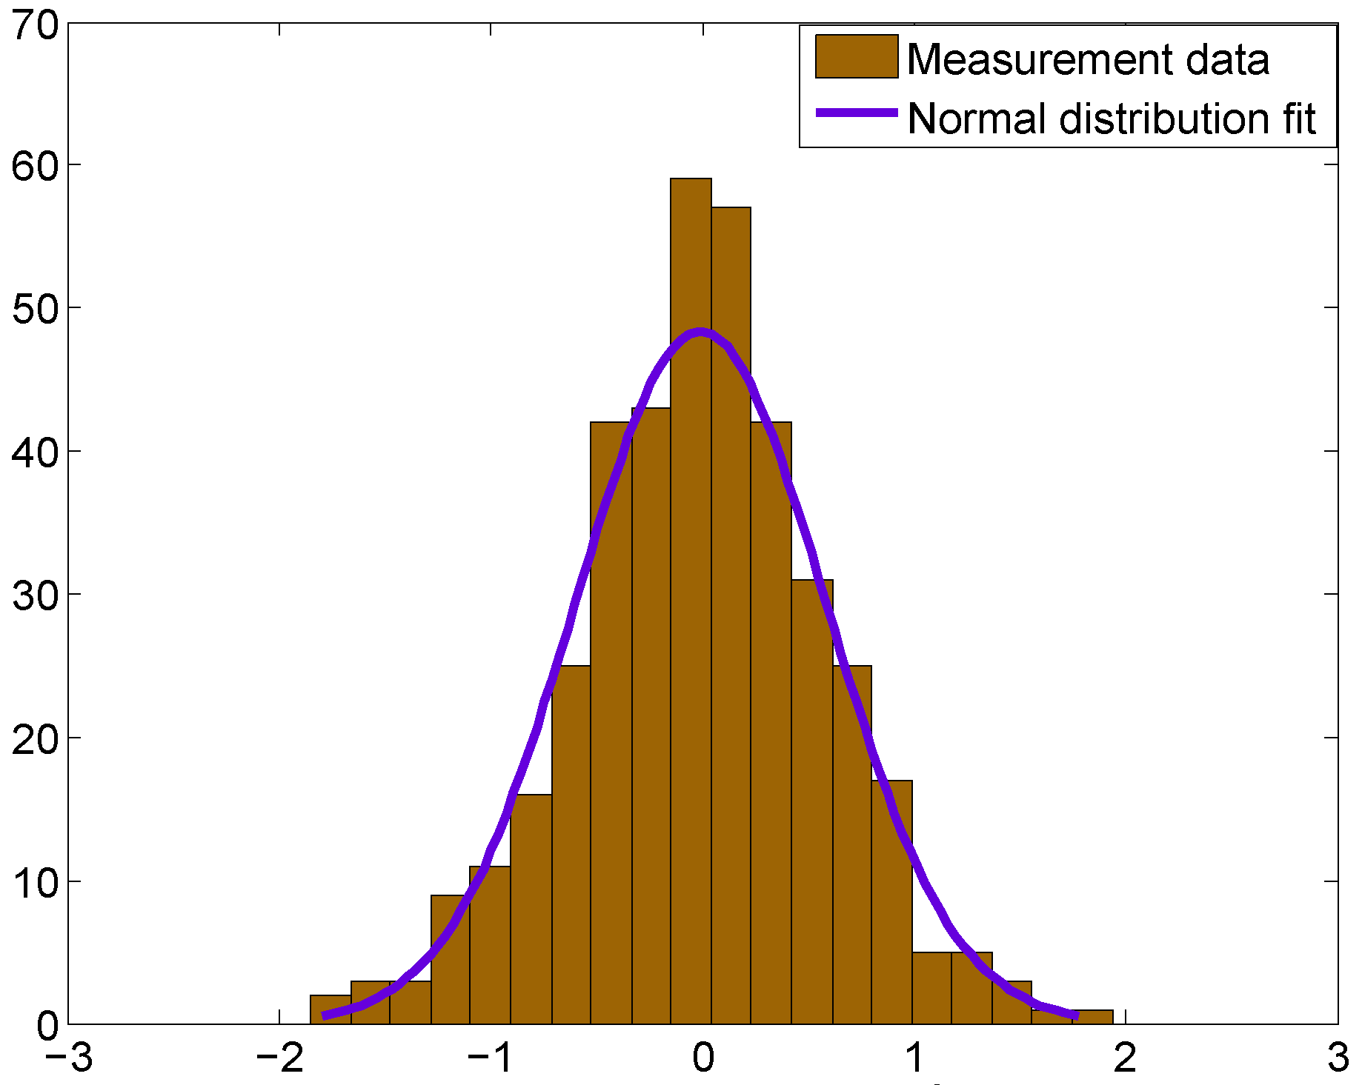
Normal Distributions

Slide 6
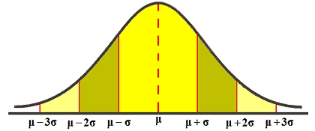
Understanding SD Graphically
68.26%
94.46%
99.73%

Slide 7
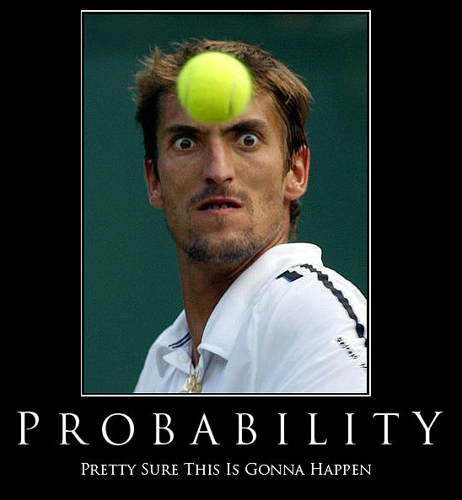
PROBABILITY

Slide 8
What is Probability?
The likelihood of an event or outcome
# of outcomes classified as A
p(A) =
total # of possible outcomes

Slide 9
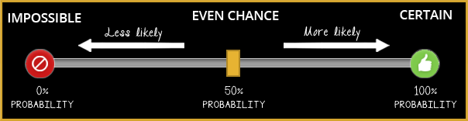
Probability and Uncertainty

Slide 10
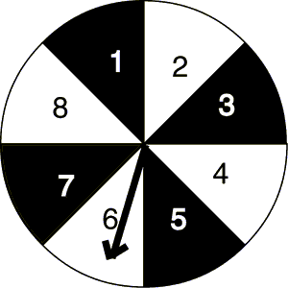

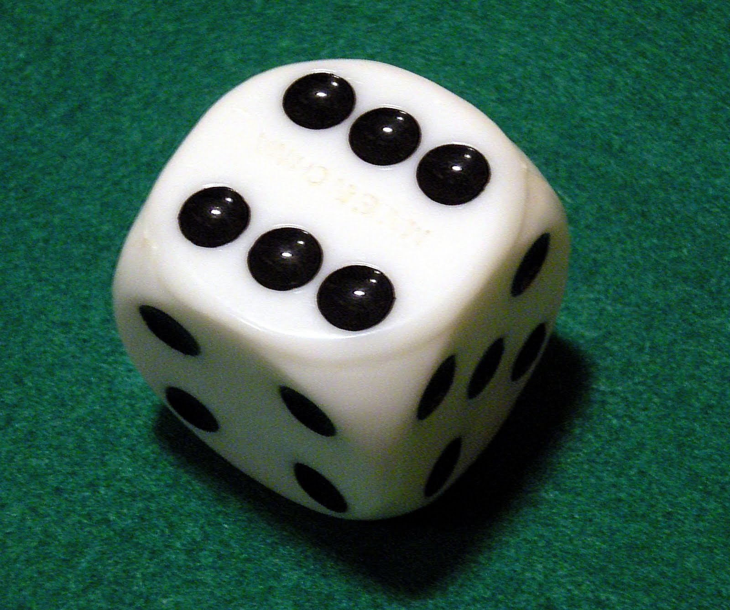



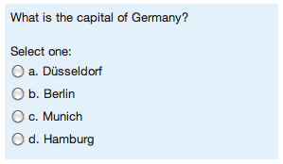



Slide 11
Which of the following numbers could not possibly be probabilities?
0.42
-0.20
1
5/6
3.5
0

Slide 12
Rules of Probability◉
Additive Rule: P(A or B) = P(A) + P(B)
◉ If A and B are independent events

Slide 13
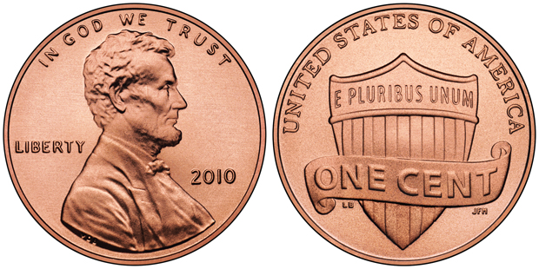
What is the probability that…
You flip a fair coin and get heads or tails?
P(heads or tails) = P(heads) + P(tails) = 0.5 + 0.5 = 1

Slide 14
Rules of Probability◉
Additive Rule: P(A or B) = P(A) + P(B)
Multiplicative Rule: P(A and B) = P(A) * P(B)
◉ If A and B are independent events

Slide 15
What is the probability that…
You flip a fair coin and get heads or tails?
You flip a coin twice and get two heads
P(heads and heads) = P(heads) * P(heads) = 0.5 * 0.5 = 0.25

Slide 16

What is the probability that…
You flip a fair coin and get heads or tails?
You flip a coin twice and get two heads
You roll a die and get a 2 and then a 4
P(2 and 4) = P(2) * P(4) = 1/6 * 1/6 = 1/36 = 0.0278

Slide 17
Rules of Probability◉
Additive Rule: P(A or B) = P(A) + P(B)
Multiplicative Rule: P(A and B) = P(A) * P(B)
Law of Large Numbers:
The average result obtained from a large number of trials should be close to the expected probability
◉ If A and B are independent events

Slide 18
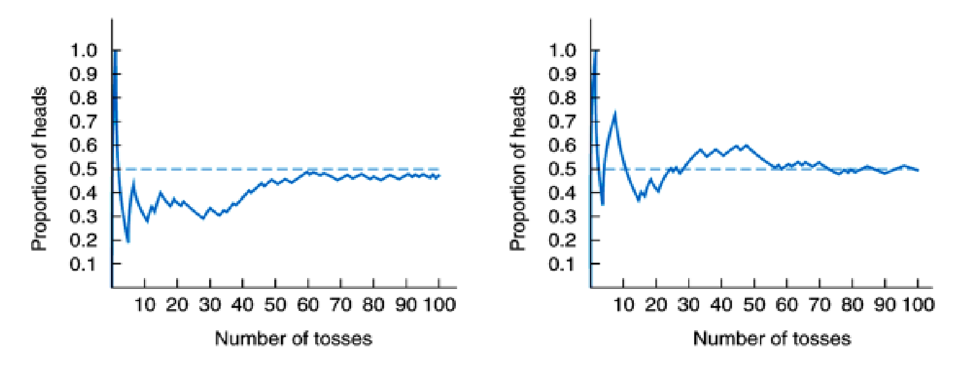
What is the probability that…
You flip a fair coin and get heads or tails?
You flip a coin twice and get two heads
You roll a die and get a 2 and then a 4
You flip a coin multiple times and get exactly 50% heads and 50% tails

Slide 19
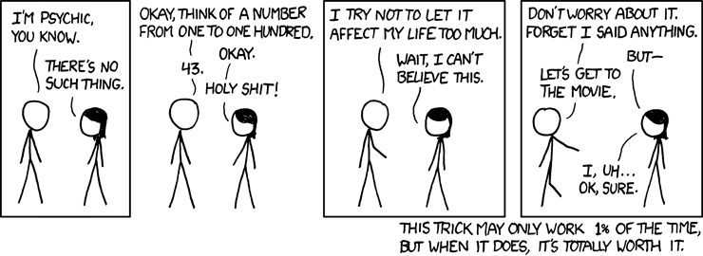
Rare events are inevitable…

Slide 20

Beware the Gambler’s Fallacy!

Slide 21
Are these events independent?
A drawer contains 3 red paperclips, 4 green paperclips, and 5 blue paperclips. I take one paperclip from the drawer and then put it back. Then, I take a second paperclip from the drawer. What is the probability that the first paperclip is red and the second paperclip is blue?
A drawer contains 3 red paperclips, 4 green paperclips, and 5 blue paperclips. I take one paperclip from the drawer and is NOT replaced. Then, I take a second from the drawer. What is the probability that the first paperclip is red and the second paperclip is blue?

Slide 22

If the events are not independent:
We have 15 fruits in a basket:
4 apples
6 oranges
5 peaches
P(orange then apple)?
= (6/15) * (4/14)
= 24/210 or .114

Slide 23
Rules of Probability
Additive Rule: P(A or B) = P(A) + P(B)
Multiplicative Rule: P(A and B) = P(A) * P(B)
Law of Large Numbers
Bayes Rule: Conditional Probability (What is the probability of A given B?)

Slide 24
Conditional Probability
Imagine there is a terrible disease that is starting to spread on college campuses. One out of every 1000 people has the disease. There is a new test that is 99% accurate, so if you have the disease there is a 99% chance it comes out positive. However, the test also has a 5% false alarm rate, so 5% of people who do not have the disease still will test positive. You take the test and it comes back positive.
What is the probability you have the disease given that you have a positive test?

Slide 25
Conditional Probability
Imagine 100,000 people take the test for the disease…
Probability of disease given that you had a positive test =
99/(99+4995) = 0.019
Less than 2% chance!
Test is Positive
Test is Negative
Has Disease
(1/1000)
99
1
Does Not Have Disease
(999/1000)
4995
94905

Slide 26
Bayes Theorem
P(A) * P(B|A)
P(B)
P(A | B) =
P(disease given positive test) =
P(disease) * P(positive test given disease)
=
P(positive test)
Test is Positive
Test is Negative
Has Disease
(1/1000)
99
1
0.99 * 0.01
=
0.019
0.05094
Does Not Have Disease
(999/1000)
4995
94905

Slide 27
Rules of Probability
Additive Rule: P(A or B) = P(A) + P(B)
Multiplicative Rule: P(A and B) = P(A) * P(B)
Law of Large Numbers
Bayes Rule: Conditional Probability

Slide 28
PROBABILITY IN RESEARCH & STATISTICS

Slide 29

Imagine a bag filled with 500 coins, an unknown amount of quarters, pennies, nickels, and dimes. You are interested in estimating the weight of this bag, but may not actually weigh every coin.
How would you estimate the weight?

Slide 30
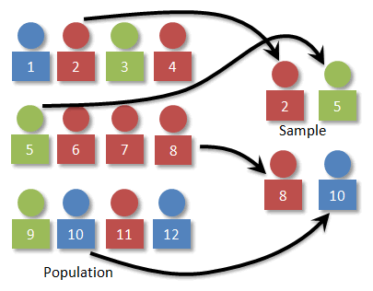
Random Sampling
Every individual in the population of interest has an equal chance of being selected

Slide 31

I want to pick a single marble (a sample) out of each of these jars (each is a population)
What are my chances of getting a black marble from each jar?
50 white
50 black
Jar A
Jar B
10 white
90 black

Slide 32
Now you are blindfolded when you pick your marble (your sample), so you do not know which jar (population) it comes from.
If you picked 4 black marbles in a row, which jar do you think it came from? How certain are you?
50 white
50 black
Jar A
Jar B
10 white
90 black

Slide 33
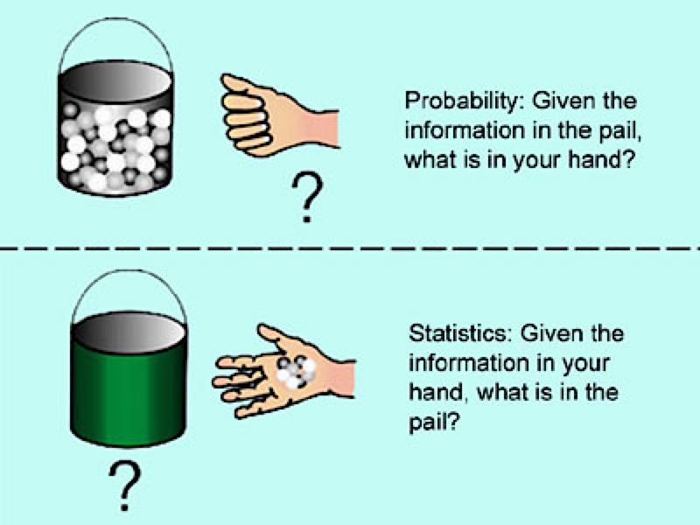
Probability and Statistics
Probability: Based on the population’s characteristics, what do we estimate our sample to look like?
Statistics: Based on the sample, what do we estimate the population to look like?

Slide 34
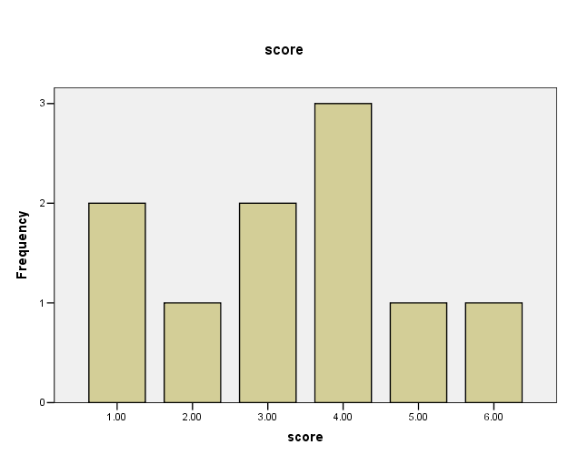
Probability and Frequency Distributions
n = 10
Scores = 1, 1, 2, 3, 3, 4, 4, 4, 5, 6
If you randomly sample one score (X), what are the odds…
p(X < 2)?
2/10 = 1/5
p(X > 3)?
5/10 = 1/2
p(X = 3)?
2/10 = 1/5
3
2
Frequency
1
1
2
3
4
5
6
Score

Slide 35
Probability and the Normal Distribution

Slide 36
What is a normal distribution?
Symmetric, unimodal, bell-shaped curve
No obvious skew
Single peak
Described by μ and σ
Many variables of interest are approximately normally distributed. Most inferential statistics are based on the assumption the population of observations is normally distributed.

Slide 37
Probability and the Normal Distribution
68.26%
94.46%
99.73%

Slide 38
Class Activity
Let’s find out the distribution of values we would expect from rolling three dice simultaneously.
Groups: One secretary, an addition person, a dice roller
Roll the three dice. The Addition person adds it up and says the number to the secretary, who writes it down.
Repeat 20 times.
https://tinyurl.com/SumDice

Slide 39
What is a standard normal distribution?
A normal distribution where μ = 0 and σ = 1
Why is this distribution helpful?
Z-Score:
-3
-2
-1
0
1
2
3
If we can transform our data to this scale, we can express an individual’s score in relation to two very important distribution characteristics: μ and σ

Slide 40
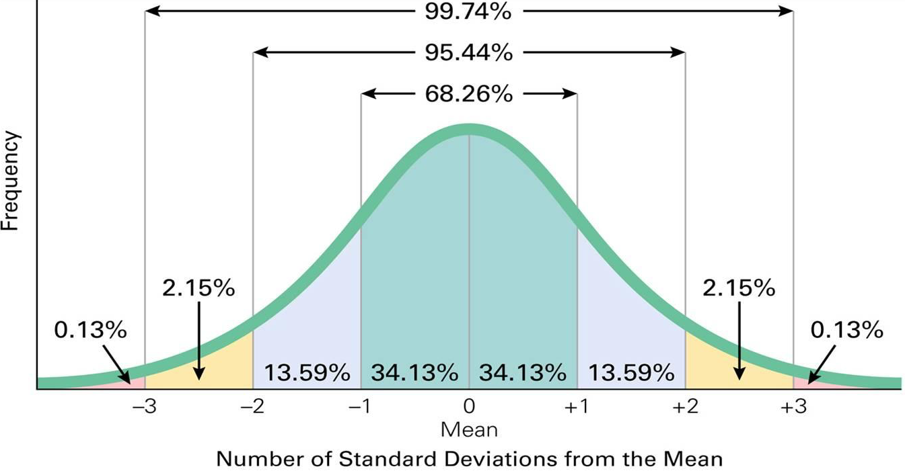
Probability and the Normal Distribution
(Standard Normal Distribution: μ = 0 and σ = 1)

Slide 41
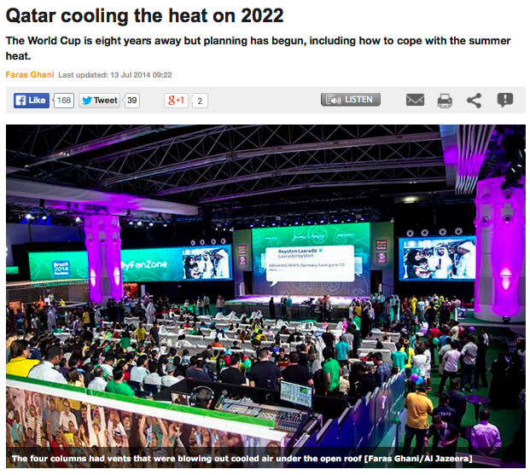
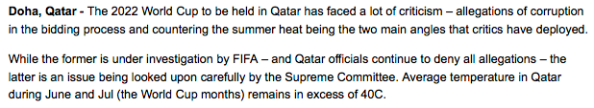

Slide 42
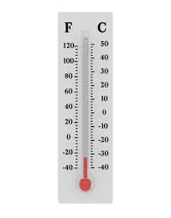
Linear Transformation
(or how hot is that in a distribution I’m familiar with?)
° F = 1.8(C) + 32
° F = 1.8(40) + 32
° F = 104°

Slide 43
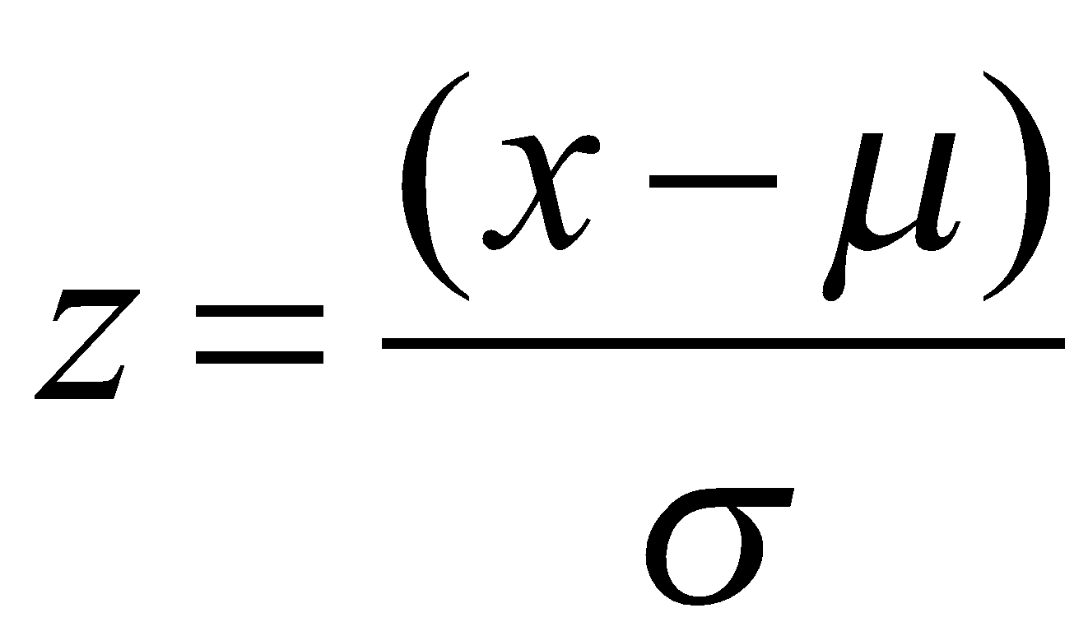
Probability and the Normal Distribution
Z-score: The number of standard deviations away from the population mean a data point is (a standardized score)
Knowing the Z-score enables us to infer where a score lands relative to other scores on our measure, and thus its probability (how frequently a value like that occurs)

Slide 44
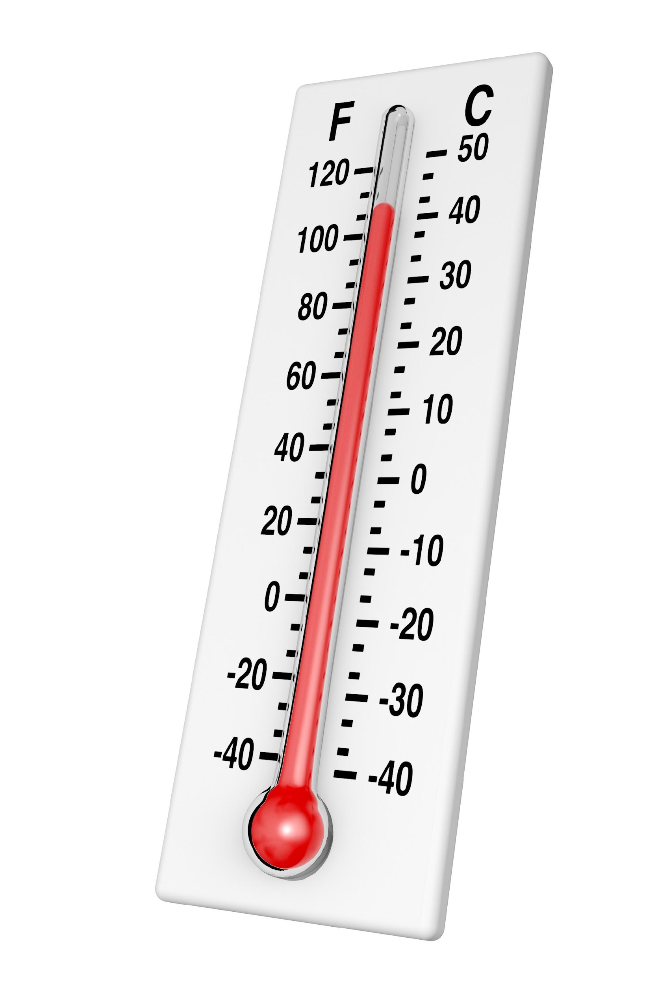
Example of using a z-score
Q: Is 104° F a generally hot temperature on earth? In other words, what’s the probability that the temperature is higher than 104° ?
Average temperature on earth: μ = 58°
SD of temperature on Earth: σ = 35°
104-58
46
=
=
=
1.31
35
35

Slide 45
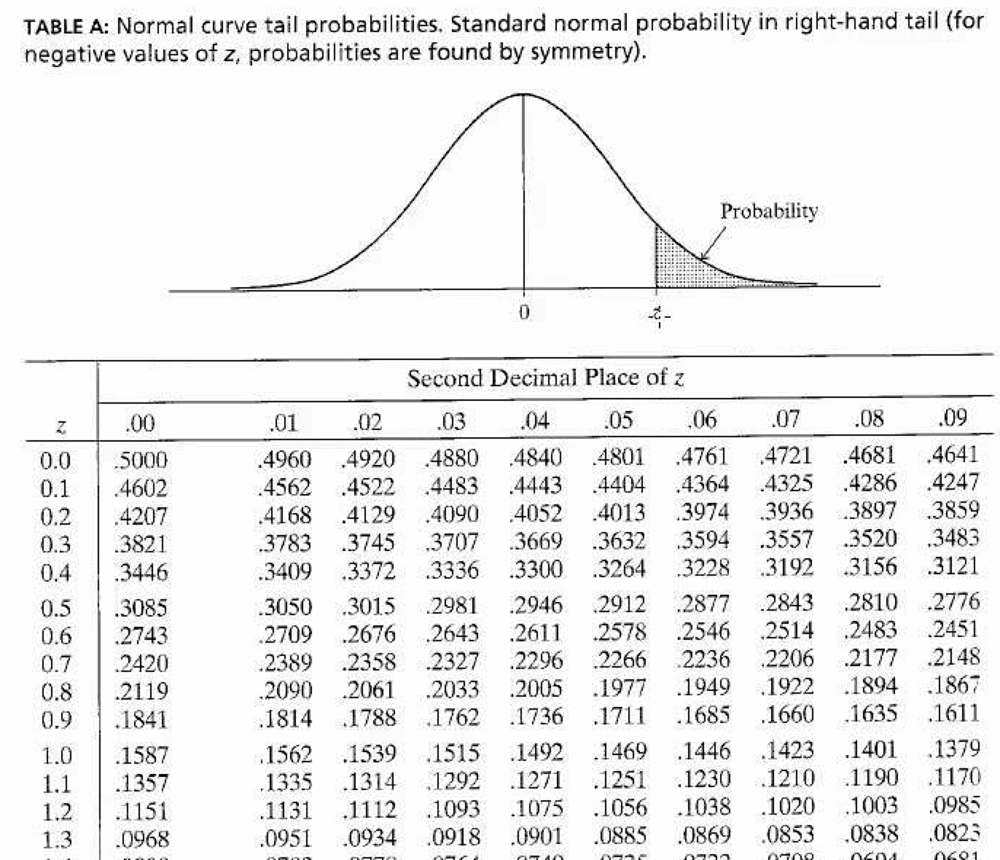
Example of using a z-score
right tail of distribution

Slide 46
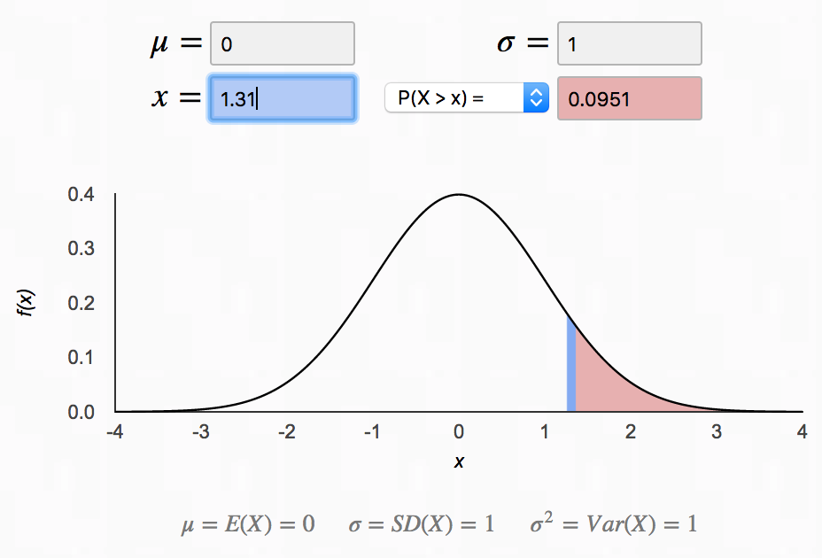
Example of using a z-score
http://homepage.divms.uiowa.edu/~mbognar/applets/normal.html

Slide 47
Example of using a z-score
Q: Is 104° F a generally hot temperature on earth? In other words, what’s the probability that the temperature is higher than 104°?
A: there’s a 9.5% chance the temperature is hotter than 104° (and thus 104° is hotter than 90.5% of recorded temperatures)

Slide 48
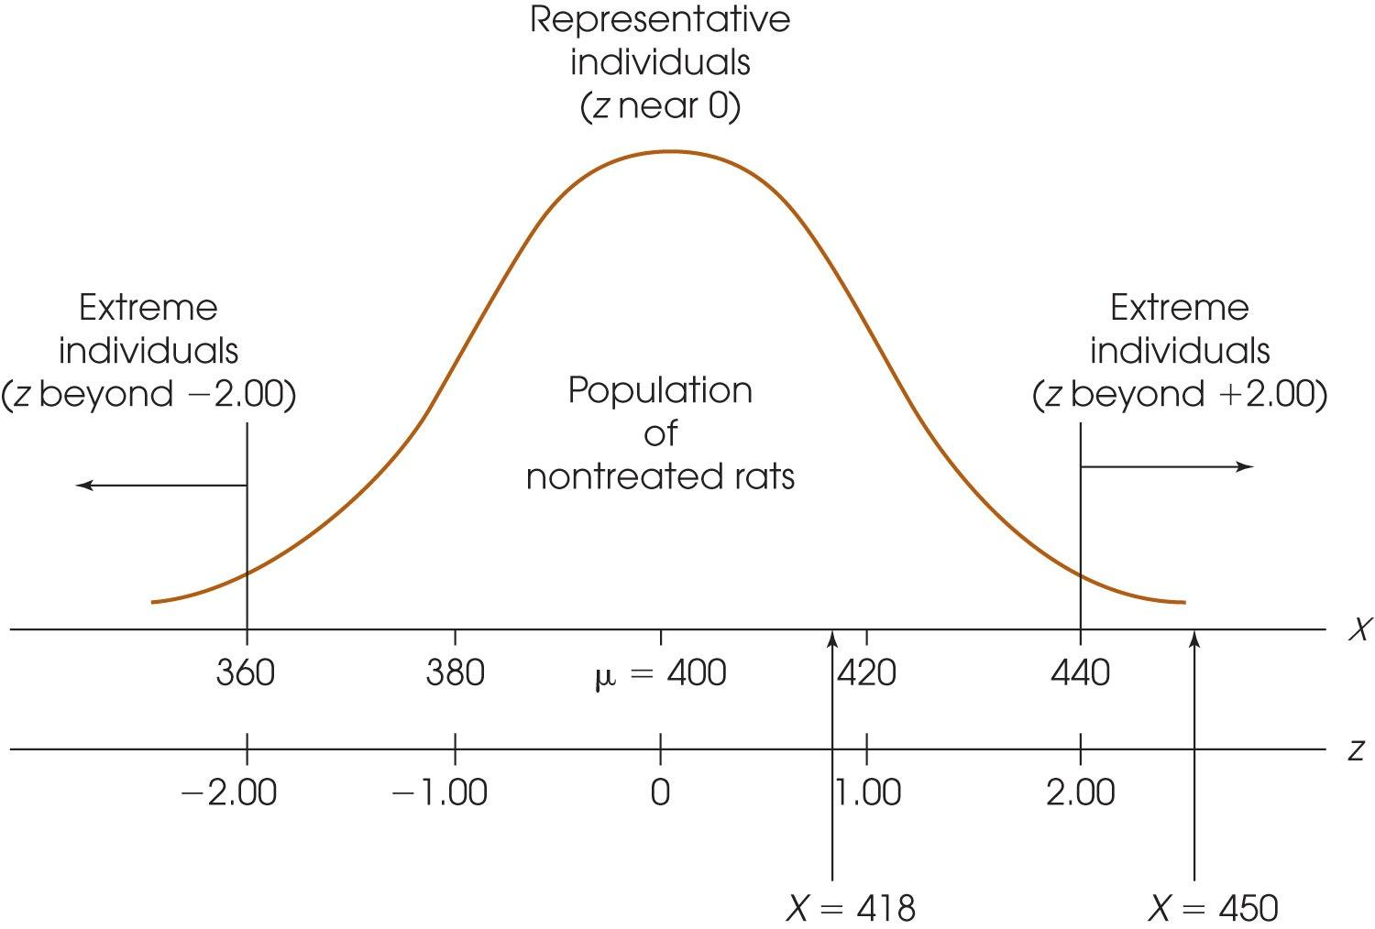
z-scores in inferential statistics
Z-score of our sample mean can help us determine if our manipulation had a significant effect
For a population of rats, the average weight is 400 grams with σ = 20. We inject one rat with growth hormone
If the rat weighs 418g, does growth hormone seem to work?
If the rat weighs 450g, does growth hormone seem to work?

Slide 49
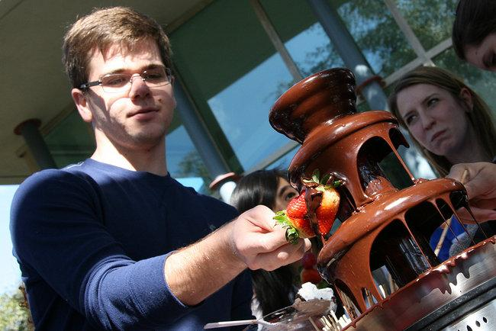
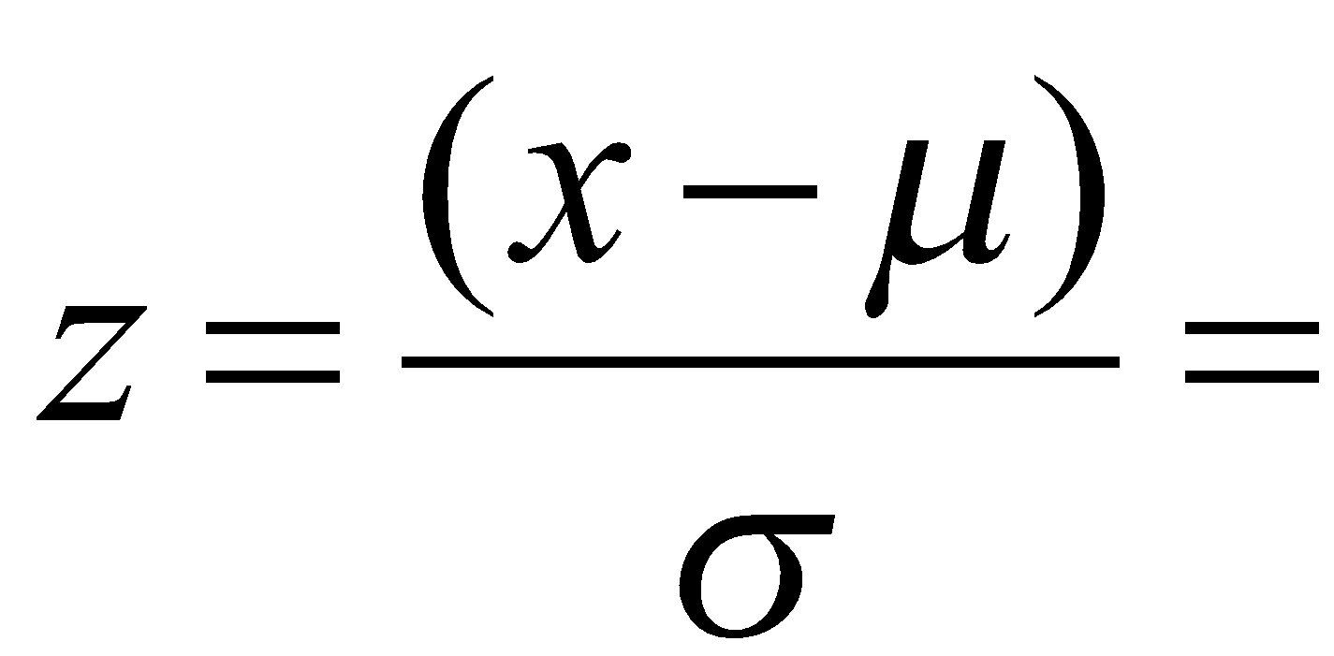
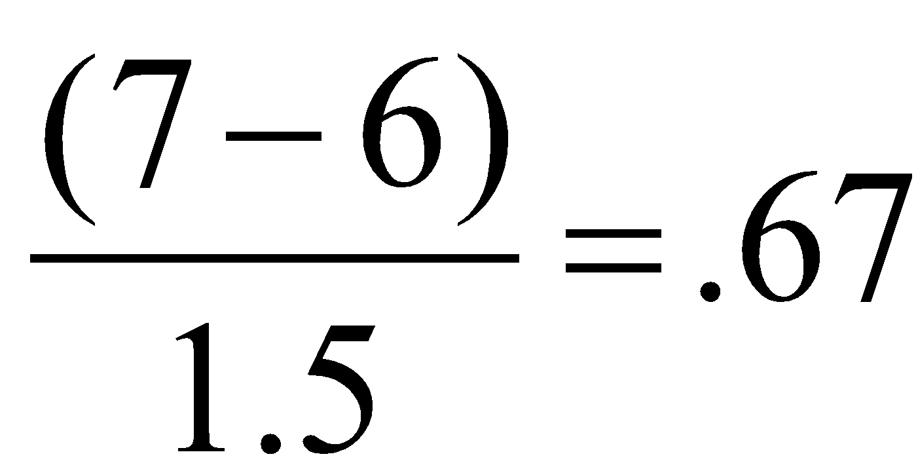
Let’s Practice
Chocolate consumption
amongst members of PC
Chocolate Club:
μ = 6
σ = 1.5
If I ate 7 pieces of chocolate, where would I be in the distribution?
Now what does that tell us?
P(X <= 7) = P(Z <= .67) = 75%

Slide 50
Another Practice Problem
The SAT has a mean of 1058 (out of 1600) and an SD of 211 points
What percentile did Terrilicia score if she got a 1364?
What percentage of students scored higher than her?
What percentage of students scored between 1300 and 1400 points?

